Slide 1
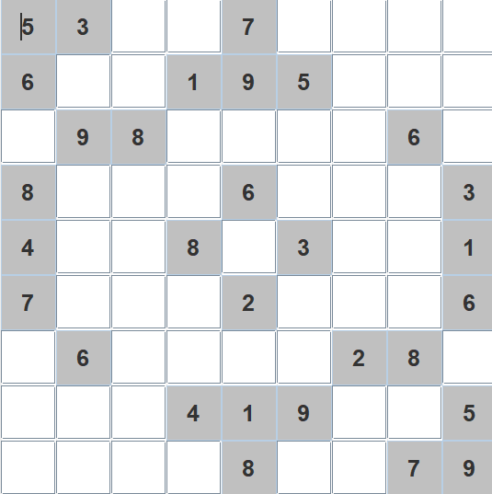
SUDOKU VISUALIZER !!
Presented by : Logeshwarn D 12210238

Slide 2
Sudoku?
->A simple but addictive puzzle, invented in the USA in 1979 and called Number Place.
->Became popular in Japan in 1986, where it was renamed Sudoku ("single number“)
-> First appeared in UK newspapers in 2004, andbecame an international craze in 2005.

Slide 3
How it's played ?
The matrix(9*9) is partially filled.
You have to fill it such that:
1-> Each row contains all of 9 digits
from 1 to 9.
2-> Each col contains all of 9 digits
from 1 to 9.
3->Each (3*3) matrix separated by
Dark lines contains all of 9 digits from 1 to 9.

Slide 4
"THAT'S WHAT PEOPLE KNOW ABOUT SUDOKU“
CODER'S KNOW A BIT MORE.
SO LETS LEARN TO DO IT OUR WAY.

Slide 5
WHAT IS BACKTRACKING ?
•As the name suggests we backtrack to find the solution.
We start with one possible move out of many available
Moves and try to solve the problem if we are able to
solve the problem with the selected move then we will
print the solution else we will backtrack and select
some other move and try to solve it. If none if the
moves work out we will claim that there is no solution
for the problem.
•Recursion is the key in backtracking
programming.

Slide 6
We are going to solve the above puzzle using.....
BACKTRACKING ALGORITHM
Find row, column of an unassigned cell If there is none,
return true .
For digits from 1 to 9
a) If there is no conflict for digit at row, column and
matrix box, assign digit to row, column .
b) Recursively try fill in rest of grid.
c) If recursion successful, return true.
c) Else, remove digit and try another If all digits have
been tried and nothing worked, return false.

Slide 7
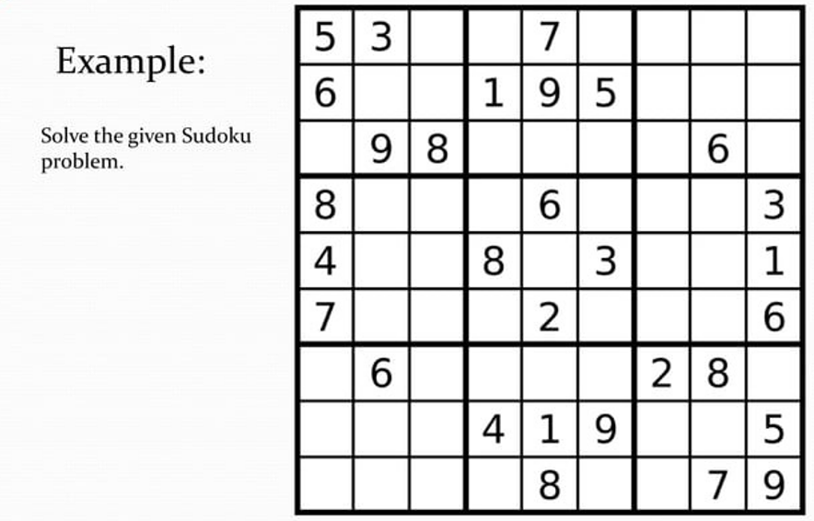

Slide 8
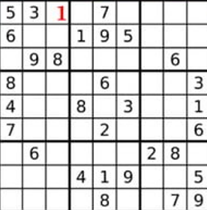
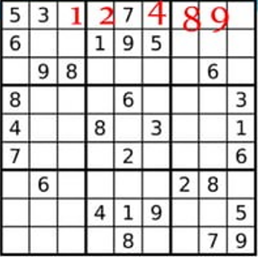
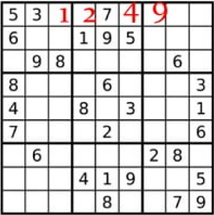
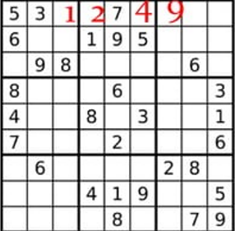

Slide 9
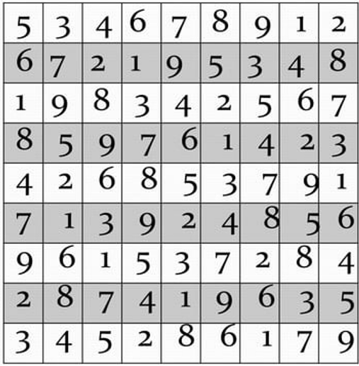

Slide 10
Some Important Points
•Backtracking algorithm will search for every possible solution.
•If You have a proper question, this method will
definitely provide a solution.
•Backtracking always provides a solution but it uses a lot of time and space to solve it.
•If problem is large enough, backtracking will take a lot of time and space and it's worthless to use it.

Slide 11
ANY QUESTIONS ?? THANK YOU

